Slide 1


Department of Applied Physics
Faculty of Science and Technology, CADI AYYAD university
Marrakesh, Morocco
Sliding Mode Active Fault-Tolerant Control for Quadrotor UAV System in Presence of Actuator Faults
Authors:
Pr. AYAD Hassan
Pr. OUADINE Ahmed Youssef
Mr. EZZARA Abderrahim
Presented by:
EZZARA Abderrahim
Notes:
Hello, everyone.
My name is Ezzara Abderrahim, and I am a PhD student in LSEEET Laboratory, Department of Applied Physics in the Faculty of Science and Technology, CADI AYYAD university, Marrakesh, Morocco. Actually, working on fault-tolerant control for autonomous vehicles.
Today, I'm looking to present a new technique for "Adaptive Observer-based Fault-Tolerant Control for Actuator Faults in Quadrotor UAVs."
Thank you for joining me today.

Slide 2
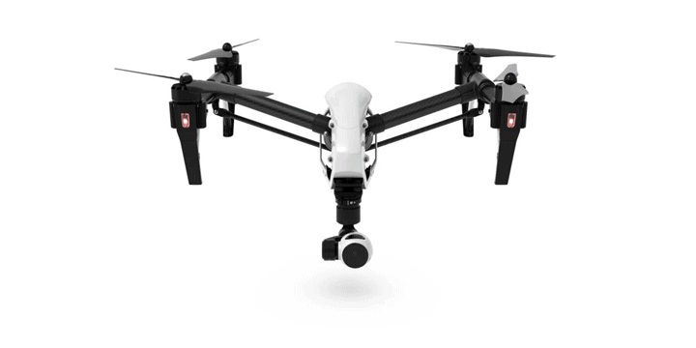
Problem statement
Faults sources
Wear and Tear;
Mechanical Damage;
Environmental Factors;
Electrical Issues;
Traditional Methods
Fault Tolerant Control (FTC)
Struggle to handle unexpected issues;
Typically designed to work under ideal conditions;
Quadrotor may become unstable, deviate from its intended path, or even crash;
FTC is a type of control system to maintain the stability and performance of a system even when faults occur.
01

Slide 3
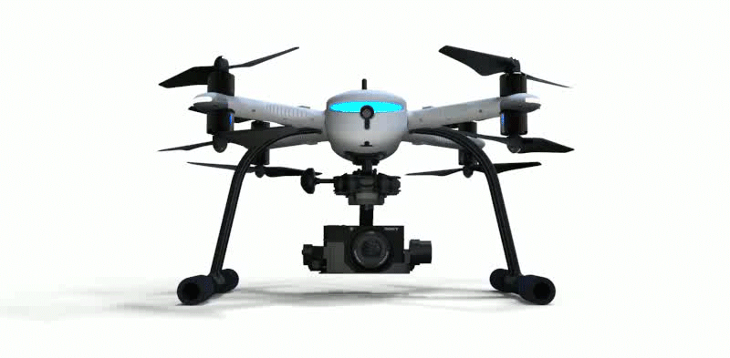
Proposed FTC
FTC Structure
Adaptive observer: Estimate the actuator faults
Sliding mode controller: Adjusts the control strategy
Actuator Faults
Desired path
Quadrotor
Adaptive observer
Estimated faults
Sliding mode Controller
FTC Bloc
02
Notes:
Many actuator-fault-tolerant control strategies have been proposed, mainly based on observer-based techniques. Using adaptive observers, it is possible to estimate faults that are represented as changes in parameters.
Unfortunately, The observer matching condition is not satisfied for our system. Therefore we cannot use the standard adaptive observer form.
The proposed FTC technique uses the backstepping technique to synthesize the control laws, taking into account the real-time faults estimated by an adaptive observer that satisfy the cited condition.

Slide 4
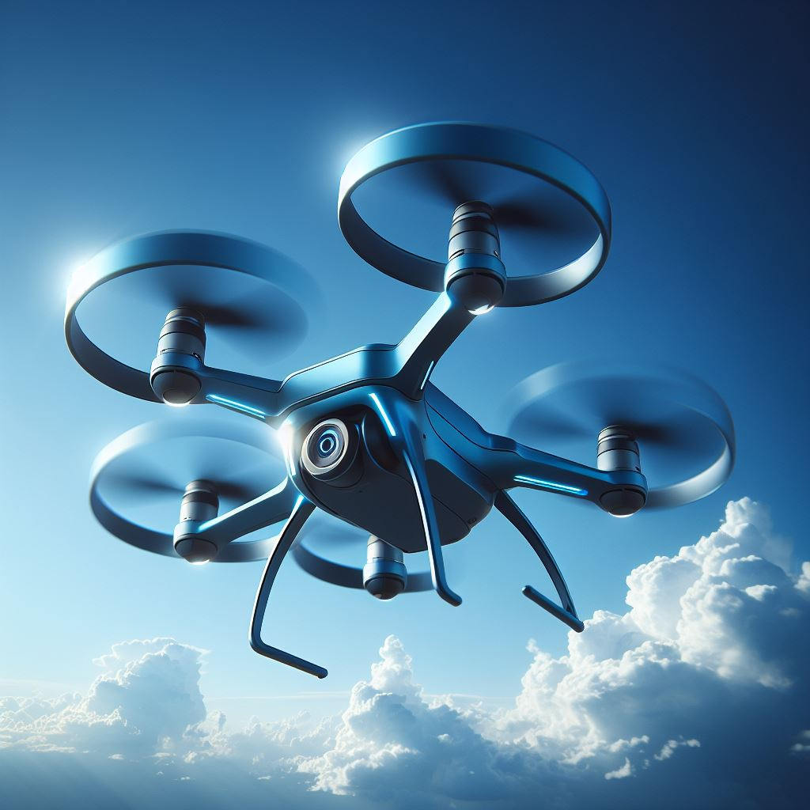
Outline
Quadrotor Nonlinear Dynamical modeling
Nonlinear adaptive observer design
Quadrotor FTC in presence of Actuator Faults
Simulation Results
Conclusion
03
03
Notes:
The first part of this presentation is : Quadrotor Nonlinear Dynamical modeling

Slide 5
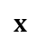

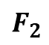
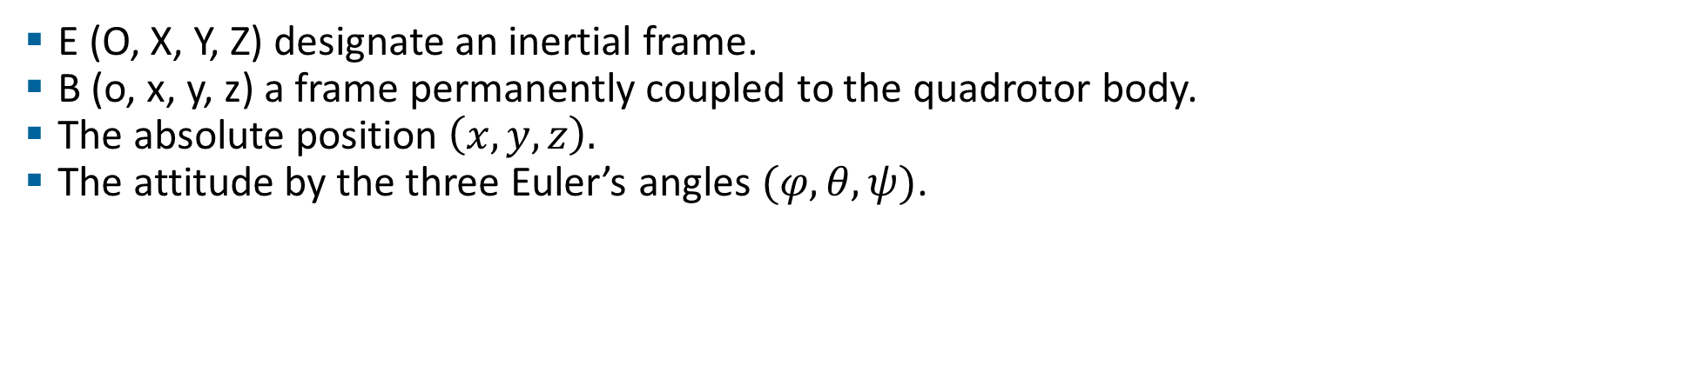
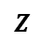
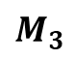
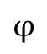
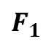
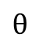
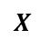
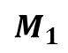
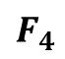
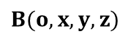
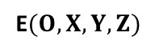
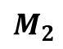
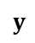
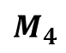
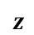
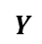
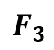
FTC Strategy
Adaptive observer
Dynamical modeling
Simulation Results
Conclusion
Nonlinear Dynamical model
E (O, X, Y, Z) designate an inertial frame.
B (o, x, y, z) a frame permanently coupled to the quadrotor body.
The absolute position $\left(x,y,z\right).$
The attitude by the three Euler’s angles $(φ,θ,ψ)$.
$$F_{4}$$
$$F_{1}$$
$$M_{4}$$
$$θ$$
$$B(o,x,y,z)$$
$$φ$$
$$M_{1}$$
$$z$$
$$y$$
$$x$$
$$F_{2}$$
$$F_{3}$$
$$Z$$
$$ψ$$
$$Y$$
$$X$$
$$M_{2}$$
$$M_{3}$$
E$(O,X,Y,Z)$
Fig. 1. Quadrotor configuration
04
Notes:
In order to establish the quadrotor model, we will need two reference frames. Let E (O, X, Y, Z) designate an inertial frame, and B (O, x, y, z) designate a frame permanently coupled to the quadrotor body, as illustrated in figure 1.
The absolute position of the quadrotor may be obtained by the three coordinates and its attitude by the three Euler’s angles, respectively:
roll angle (rotation around the x-axis)
pitch angle (rotation around the y-axis)
and yaw angle (represent the rotation around the z-axis).

Slide 6
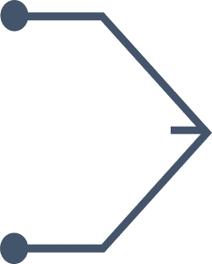
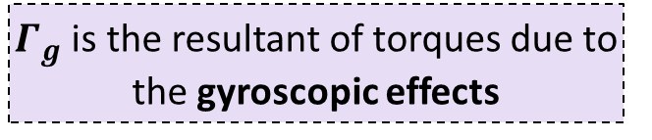
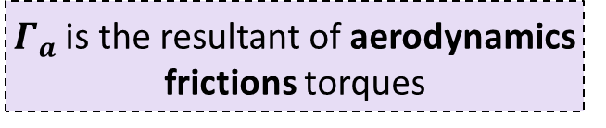
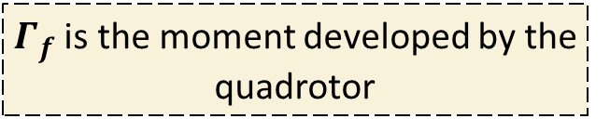
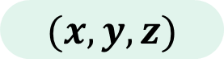
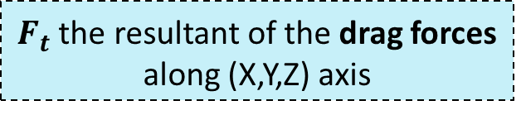
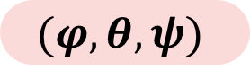
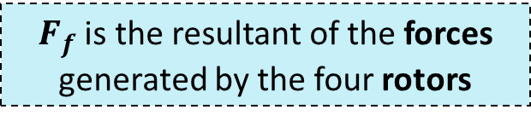

FTC Strategy
Adaptive observer
Dynamical modeling
Simulation Results
Conclusion
The quadrotor dynamical model can be derived using the Newton-Euler formalism.
$F_{f}$ is the resultant of the forces generated by the four rotors
$$(φ,θ,ψ)$$
$F_{t}$ the resultant of the drag forces along (X,Y,Z) axis
Forces
Attitude coordinates
$F_{g}$ is the gravity force
Newton-Euler formalism
$Γ_{f}$ is the moment developed by the quadrotor
Moment
Position coordinates
$Γ_{a}$ is the resultant of aerodynamics frictions torques
Torques
$Γ_{g}$ is the resultant of torques due to the gyroscopic effects
$$(x,y,z)$$
05
Notes:
The quadrotor dynamical model can be derived using the Newton-Euler formalism.
Various physical phenomena that might impact its dynamics are taken into account, for example:
The forces generated by the four rotors.
The drag forces along (X,Y,Z) axis.
The gravity force.
The moment developed by the quadrotor.
The resultant of aerodynamics frictions torques.
The resultant of torques due to the gyroscopic effects.
Using Newton-Euler formalism and taking in to account these forces, moments and torques, we can extract the attitude and the position coordinates of the quadrotor.

Slide 7
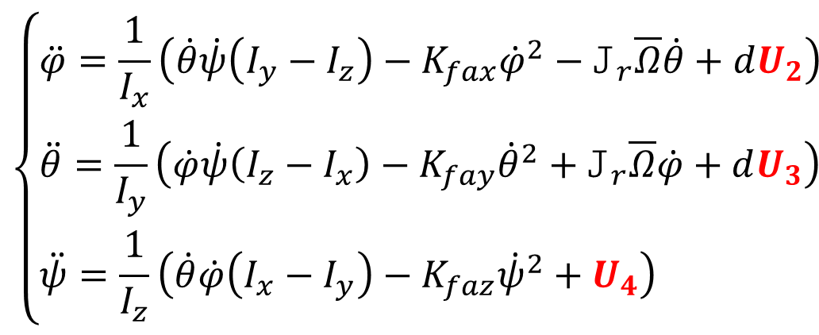
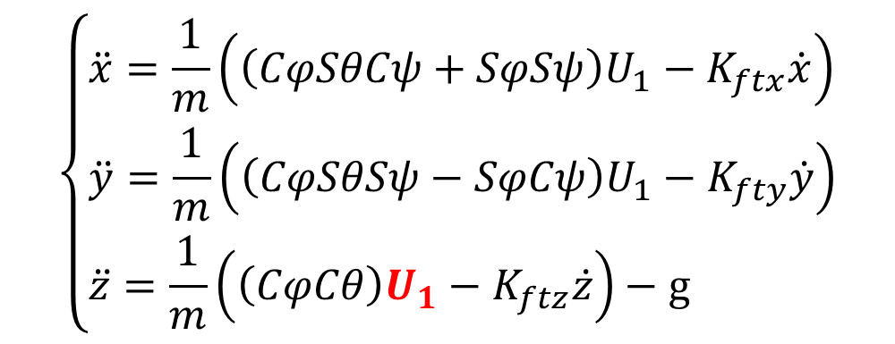
FTC Strategy
Adaptive observer
Dynamical modeling
Simulation Results
Conclusion
The quadrotor's dynamic model:
$$\left\{\begin{aligned}&\ddot{φ}=\frac{1}{I_{x}}\left(\dot{θ}\dot{ψ}\left(I_{y}−I_{z}\right)−K_{fax}{\dot{φ}}^{2}−J_{r}\overline{Ω}\dot{θ}+dU_{2}\right) \\ &\ddot{θ}=\frac{1}{I_{y}}\left(\dot{φ}\dot{ψ}\left(I_{z}−I_{x}\right)−K_{fay}{\dot{θ}}^{2}+J_{r}\overline{Ω}\dot{φ}+dU_{3}\right) \\ &\ddot{ψ}=\frac{1}{I_{z}}\left(\dot{θ}\dot{φ}\left(I_{x}−I_{y}\right)−K_{faz}{\dot{ψ}}^{2}+U_{4}\right)\end{aligned}\right.$$
$$\left\{\begin{aligned}&\ddot{x}=\frac{1}{m}\left(\left(CφSθCψ+SφSψ\right)U_{1}−K_{ftx}\dot{x}\right) \\ &\ddot{y}=\frac{1}{m}\left(\left(CφSθSψ−SφCψ\right)U_{1}−K_{fty}\dot{y}\right) \\ &\ddot{z}=\frac{1}{m}\left(\left(CφCθ\right)U_{1}−K_{ftz}\dot{z}\right)−g\end{aligned}\right.$$
06
Notes:
The quadrotor's dynamic model, is given by these equations, where :
$U_{1}$, $U_{2}$, $U_{3}$, and $U_{4}$ represent the control inputs of the system

Slide 8
Outline
Quadrotor Nonlinear Dynamical modeling
Nonlinear adaptive observer design
FTC Strategy of Quadrotor in presence of Actuator Faults
Simulation Results
Conclusion
07
Notes:
Let us now move to the second part : Nonlinear adaptive observer design

Slide 9
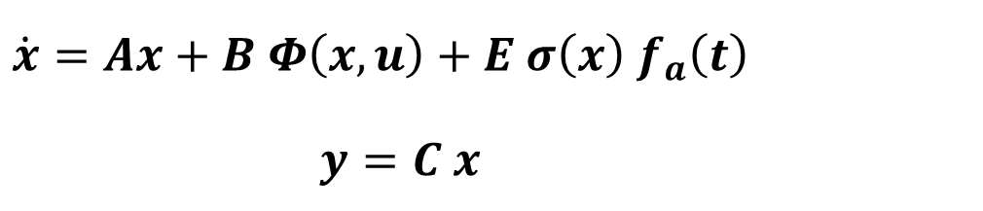
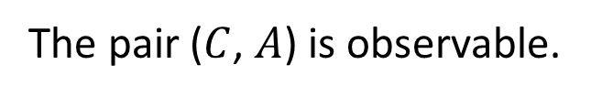
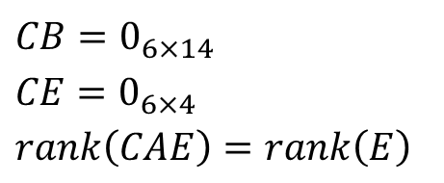
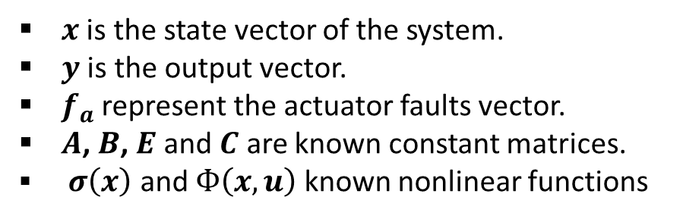
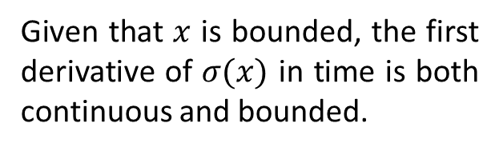
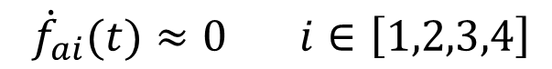
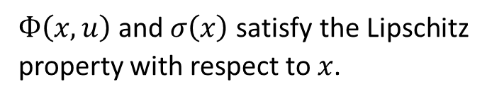

FTC Strategy
Adaptive observer
Dynamical modeling
Simulation Results
Conclusion
The complete model may be expressed in state-space form:
$$\dot{x}=Ax+B Φ\left(x,u\right)+E σ\left(x\right){ f}_{a}\left(t\right)$$
$$y=C x$$
$x$ is the state vector of the system.
$y$ is the output vector.
$f_{a}$ represent the actuator faults vector.
$A$, $B$, $E$ and $C$ are known constant matrices.
$σ\left(x\right)$ and $Ф\left(x,u\right)$ known nonlinear functions
1
The pair ($C$, $A$) is observable.
4
${\dot{f}}_{ai}(t)≈0 i∈\left[1,2,3,4\right]$
$Ф\left(x,u\right)$ and $σ\left(x\right)$ satisfy the Lipschitz property with respect to $x$.
2
$$CB=0_{6×14}$$
$$CE=0_{6×4}$$
$$rank\left(CAE\right)=rank\left(E\right)$$
5
$$\left\|f_{a}(t)\right\|≤γ_{3}$$
3
6
Given that $x$ is bounded, the first derivative of $σ(x)$ in time is both continuous and bounded.
08
Notes:
The complete model may be expressed in state-space form as below.
The following assumptions are considered:
The first assumption: The pair ($C$, $A$) is observable;
The second assumption: $Ф\left(x,u\right)$ and $σ\left(x\right)$ satisfy the Lipschitz property with respect to $x$.
thirdly : The fault vector $f_{a}$ is bounded in the following sense:
Assumption number four: The actuator faults are piecewise constant and slowly vary in time as follows:
The fifth assumption: System matrices satisfy the following condition
The last assumption: Given that $x$ is bounded, the first derivative of $σ(x)$ in time is both continuous and bounded.

Slide 10
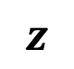

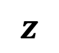
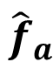
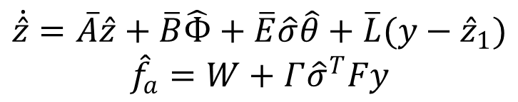
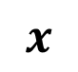
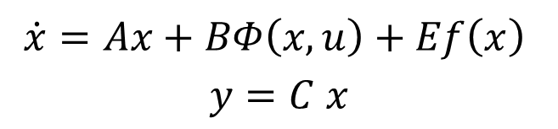
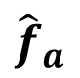
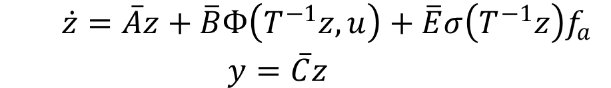
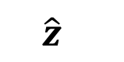
FTC Strategy
Adaptive observer
Dynamical modeling
Simulation Results
Conclusion
Original system
$$x$$
Coordinate change
$$\dot{x}=Ax+BΦ\left(x,u\right)+Ef\left(x\right)$$
$$y=C x$$
$$z = T x$$
New system
$$z$$
$$\dot{z}=\overline{A}z+\overline{B}Ф\left(T^{−1}z,u\right)+\overline{E}σ\left(T^{−1}z\right)f_{a}$$
$$y=\overline{C}z$$
$$z$$
$${\hat{f}}_{a}$$
Adaptive observer representation
$$\dot{\hat{z}}=\overline{A}\hat{z}+\overline{B}\hat{Ф}+\overline{E}\hat{σ}\hat{θ}+\overline{L}(y−{\hat{z}}_{1})$$
$${\hat{f}}_{a}=W+Γ{\hat{σ}}^{T}Fy$$
09
$$\hat{z}$$
$${\hat{f}}_{a}$$
Notes:
Define new coordinates as $z = T x$, where
The original system takes the following form in the new coordinate system:
Based on the new system state space representation, we suggest the following adaptive observer:
Then, both the system state and the actuator faults can be simultaneously estimated by the adaptive observer

Slide 11
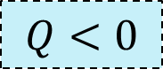
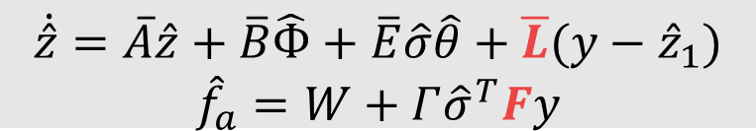









FTC Strategy
Adaptive observer
Dynamical modeling
Simulation Results
Conclusion
1
2
3
Theorem 1
If the above assumptions are satisfied the observation error is asymptotically stable, and the fault estimation error remains bounded, such that:
$$P>0$$
$$Q<0$$
$$E_{2}^{T}P_{3}=FA_{12}$$
LMI optimization
(Simultaneous solve of 1, 2 and 3 )
$$P=\left[\begin{matrix}P_{1} & P_{2} \\ P_{2} & P_{3}\end{matrix}\right]>0$$
1
$$Q=\left[\begin{matrix}Λ & P\overline{B} & P\overline{E} \\ {\overline{B}}^{T}P & −ε_{1}I_{14} & 0_{14×4} \\ {\overline{E}}^{T}P & 0_{4×14} & −ε_{2}I_{4}\end{matrix}\right]<0$$
$$\text{P}\text{, }\text{M} \text{and} \text{F}$$
2
$$F$$
$$\overline{L}=P^{−1}M{\overline{C}}^{T}$$
3
$$E_{2}^{T}P_{3}=FA_{12}$$
$P=P^{T}>0$, $F$ and $M=M^{T}.$
And $ε_{1}>0$ and $ε_{2}>0$
$$\dot{\hat{z}}=\overline{A}\hat{z}+\overline{B}\hat{Ф}+\overline{E}\hat{σ}\hat{θ}+\overline{L}(y−{\hat{z}}_{1})$$
$${\hat{f}}_{a}=W+Γ{\hat{σ}}^{T}Fy$$
10
Notes:
Theorem 1 provides a strategy to design an adaptive observer using a LMI formulation.
Once the previous conditions are satisfied, the observer gain L is selected as
The vector $e_{f}$ converges to zero.

Slide 12









FTC Strategy
Adaptive observer
Dynamical modeling
Simulation Results
Conclusion
An active fault-tolerant tracking control system approach for actuator faults.
Adaptive
observer
Estimated faults
$${\hat{f}}_{a}=\left[\begin{aligned}&{\hat{f}}_{a1} \\ &{\hat{f}}_{a2} \\ &{\hat{f}}_{a3} \\ &{\hat{f}}_{a4}\end{aligned}\right]$$
$$X$$
Fault tolarent controller
U1
Ux
$$X$$
Uy
$$\left[\begin{aligned}&x_{d} \\ &y_{d} \\ &z_{d} \\ &ψ_{d}\end{aligned}\right]$$
Nonholonomic constraints
$$φ_{d}$$
U2
$$U$$
$$θ_{d}$$
U3
U4
Quadrotor
$${[x_{d},y_{d},z_{d},ψ_{d}] }^{T}$$
$$f_{a}=\left[\begin{aligned}&f_{a1} \\ &f_{a2} \\ &f_{a3} \\ &f_{a4}\end{aligned}\right]$$
Real faults
11
Notes:
By adding this adaptive observer, our complete fault tolerant control strategy is given by the following scheme.
In this structure the adaptive observer allows to estimate the actuator faults.
These estimates are then taken into account by the control laws to form an active fault tolerant control.

Slide 13
Outline
Quadrotor Nonlinear Dynamical modeling
Nonlinear adaptive observer design
Quadrotor FTC in presence of Actuator Faults
Simulation Results
Conclusion
12
Notes:
Let us go to the third part : Quadrotor Fault Tolerant Control in presence of Actuator Faults

Slide 14







FTC Strategy
Adaptive observer
Dynamical modeling
Simulation Results
Conclusion
An iterative algorithm is employed to synthesize the control laws.
$$e_{i}=x_{i}−x_{id}$$
$$s_{i}={\dot{e}}_{i}+k_{i}e_{i}$$
$$e_{i}=x_{i}−x_{id}$$
1
$$V_{i}=\frac{1}{2}s_{i}^{2}+\frac{1}{{2α}_{i}}{{\tilde{Γ}}_{i}}^{2}$$
$$s_{i}={\dot{e}}_{i}+k_{i}e_{i}$$
2
SMC Approach
(Find $U_{i}$ such that $V_{i}≤0$)
$$V_{i}=\frac{1}{2}s_{i}^{2}+\frac{1}{{2α}_{i}}{{\tilde{Γ}}_{i}}^{2}$$
3
$E\text{xtract}$ control laws
$$U_{1},U_{2},U_{3},U_{4}$$
where ${\dot{\hat{Γ}}}_{i}=α_{i}\left|s_{i}\right|$
13
Notes:
The SMC technique is used to generate control laws leading the system to follow the desired path in the normal and the faulty case.
$e_{i}$ is the tracking error
$s_{i}$ is the sliding surfaces
$V_{i}$ are the Lyapunov functions
Using the backstepping approach, we can extract control laws ($U_{1},U_{2},U_{3},U_{4}$)

Slide 15

FTC Strategy
Adaptive observer
Dynamical modeling
Simulation Results
Conclusion
The synthesized stabilizing control laws are as described in the following:
$$U_{1}=\frac{m}{cx_{1}cx_{2} }\left[{\ddot{z}}_{d}−\right.\left.a_{11}x_{12}+g−k_{6}{\dot{e}}_{6}−A_{6}s_{6}−{\hat{f}}_{a4}−{\hat{Γ}}_{6} sign\left(s_{6}\right)\right]$$
$$U_{2}=\frac{1}{b_{1}}\left[{\ddot{φ}}_{d}−a_{1}x_{8}x_{9}−a_{2}x_{7}^{2}−a_{3}\overline{Ω}x_{8}{−k}_{1}{\dot{e}}_{1}−A_{1}s_{1}−{\hat{f}}_{a1}−{\hat{Γ}}_{1} sign\left(s_{1}\right)\right]$$
$$U_{3}=\frac{1}{b_{2}}\left[{\ddot{θ}}_{d}−\right.a_{4}x_{7}x_{9}−a_{5}x_{8}^{2}−a_{6}\overline{Ω}x_{7}−k_{2}{\dot{e}}_{2}−A_{2}s_{2}−{\hat{f}}_{a2}−{\hat{Γ}}_{2} sign\left(s_{2}\right)]$$
$$U_{4}=\frac{1}{b_{3}}\left[{\ddot{ψ}}_{d}−\right.\left.a_{7}x_{7}x_{8}−a_{8}x_{9}^{2}−k_{3}{\dot{e}}_{3}−A_{3}s_{3}−{\hat{f}}_{a3}−{\hat{Γ}}_{3} sign\left(s_{3}\right)\right]$$
14
Notes:
This command benefits from the SMC properties, such as robustness,
and it allows a real time fault compensation because it takes into account the estimated faults.

Slide 16
Outline
Quadrotor Nonlinear Dynamical modeling
Nonlinear adaptive observer design
Quadrotor FTC in presence of Actuator Faults
Simulation Results
Conclusion
15
Notes:
Let us pass to the fourth section : Simulation Results

Slide 17


FTC Strategy
Adaptive observer
Dynamical modeling
Simulation Results
Conclusion
We executed simulations in MATLAB/SIMULINK® environment.
The quadrotor object of our study is the Draganfly IV, manufactured by Draganfly Innovations.
Two actuator faults related to $φ \left(f_{a1}\right) and z$ $(f_{a4})$ are introduced.
16
Notes:
In order to evaluate the performance and effectiveness of the proposed approach, we executed simulations in MATLAB/SIMULINK® environment.
The LMIs were solved using CVX, a MATLAB-based modeling system for convex optimization.
The quadrotor object of our study is the Draganfly IV, manufactured by Draganfly Innovations.
Two actuator faults related to $φ \left(f_{a1}\right) and z$ $(f_{a4})$ are introduced.

Slide 18
FTC Strategy
Adaptive observer
Dynamical modeling
Simulation Results
Conclusion
A. States estimation
The estimated states converge to the real ones accurately before and after the fault occurrence.
Desired state
Traditional SMC
FTC-SMC
Fig. 2. Trajectories over roll (𝜑), pitch (θ), yaw angle (ψ), and altitude (z)
17
Notes:
The state estimates in the faulty case are shown in Figure 2.
It can be seen that the real states converge to the desired ones even in the presence of faults,
which clearly illustrates the good performance and robustness of the control strategy.

Slide 19
FTC Strategy
Adaptive observer
Dynamical modeling
Simulation Results
Conclusion
A. States estimation
The estimated states converge to the real ones accurately before and after the fault occurrence.
Desired state
Traditional SMC
FTC-SMC
Fig. 3. Trajectories over roll (𝜑), and altitude (z)
18
Notes:
Let's zoom in on the roll (𝜑) and altitude (z) states affected by faults.

Slide 20

FTC Strategy
Adaptive observer
Dynamical modeling
Simulation Results
Conclusion
B. Fault estimation
Convergence time of less than 1 second, ensuring fast fault detection.
$RMSE \left(f_{a1}\right)=0.02 rad$
$RMSE (f_{a4})=0.30 m$
Fig. 4. Fault estimation
19
Notes:
The convergence time of less than 1 second ensures rapid fault detection.
The RMSE of $0.02 rad$ for $f_{a1}$ , and $0.30 m$ for $f_{a4}$, indicates precise fault estimation
Therefore, the proposed observer can give a fast and accurate fault estimation.

Slide 21
FTC Strategy
Adaptive observer
Dynamical modeling
Simulation Results
Conclusion
C. The quadrotor's global trajectory in 3D
Excellent performance and resilience towards stability and tracking despite the occurrence of actuator failures.
Fig.5. The quadrotor's global trajectory in 3D
20
Notes:
Figure 5 presents the 3D location of the quadrotor in the faulty scenario.
It demonstrates excellent performance and resilience towards stability and tracking despite the occurrence of actuator failures.

Slide 22

FTC Strategy
Adaptive observer
Dynamical modeling
Simulation Results
Conclusion
D. Estimation errors
E. Control inputs
 | $RMSE(φ)$ [rad] | $RMSE(z)$ [m]
Traditional SMC | $${10}^{−3}$$ | $$0.5$$
FTC-SMC | $${10}^{−5}$$ | $${10}^{−4}$$
The input control signals are acceptable and physically realizable.
Traditional SMC
FTC--SMC
Fig.6. Tracking errors
Fig.7. Control inputs of actuators in faulty case
21
Notes:
The SMC-based FTC method shows significant improvements over traditional SMC. This demonstrates the enhanced precision and fault tolerance of the proposed approach.
The input control signals are acceptable and physically realizable.

Slide 23
Outline
Quadrotor Nonlinear Dynamical modeling
Nonlinear adaptive observer design
Quadrotor FYC in presence of Actuator Faults
Simulation Results
Conclusion
22
Notes:
we end with conclusion

Slide 24


FTC Strategy
Adaptive observer
Dynamical modeling
Simulation Results
Conclusion
The used observer does not require that the system structure meets the required standard observer matching requirement for the traditional ASO.
Regardless of the number of tracked outputs, both additive and multiplicative faults can be estimated.
3
4
Both system state and the actuator faults can be simultaneously estimated by the used AO.
2
5
RMSE values in the faulty case less than ${10}^{−4} rad$.
1
The contributions of this work
6
The non-linearity of the quadrotor and the high-order non-holonomic constraints are not neglected.
It made it possible to precisely estimate the faults and ensure stability and trajectory tracking using an LMI optimization problem.
23
Notes:
The non-linearity of the quadrotor and the high-order non-holonomic constraints are not neglected.
Both system state and the actuator faults can be simultaneously estimated by the used AO.
The used observer does not require that the system structure meets the required standard observer matching requirement for the traditional ASO.
Regardless of the number of tracked outputs, both additive and multiplicative faults can be estimated.
RMSE values in the faulty case less than ${10}^{−4} rad$.
It made it possible to precisely estimate the faults and ensure stability and trajectory tracking using an LMI optimization problem.

Slide 25
Thank you for your attention
Sliding Mode Active Fault-Tolerant Control for Quadrotor UAV System in Presence of Actuator Faults

Slide 26
Department of Applied Physics
Faculty of Science and Technology, CADI AYYAD university
Marrakesh, Morocco
Sliding Mode Active Fault-Tolerant Control for Quadrotor UAV System in Presence of Actuator Faults
Authors:
Pr. AYAD Hassan
Pr. OUADINE Ahmed Youssef
Mr. EZZARA Abderrahim
Presented by:
EZZARA Abderrahim
Notes:
Hello, everyone.
My name is Ezzara Abderrahim, and I am a PhD student in LSEEET Laboratory, Department of Applied Physics in the Faculty of Science and Technology, CADI AYYAD university, Marrakesh, Morocco. Actually, working on fault-tolerant control for autonomous vehicles.
Today, I'm looking to present a new technique for "Adaptive Observer-based Fault-Tolerant Control for Actuator Faults in Quadrotor UAVs."
Thank you for joining me today.

Slide 27
Annex

Slide 28

Parameters
C and S represent the trigonometrical functions cosines and sines respectively.
$m$ is the total mass of the quadrotor.
$g$ is the gravity acceleration constant.
$K_{d}$ is the drag coefficient.
$I_{x}$, $I_{y}$ and $I_{z}$ are the constants inertia.
$K_{ftx}$, $K_{fty}$and $K_{ftz}$ are the translation drag coefficients.
$K_{fax}$, $K_{fay}$and $K_{faz}$ are the aerodynamic friction coefficients around x, y, and z.
$d$ is the distance between the quadrotor center of mass and the rotation axis of propellers.
$J_{r}$ is the rotor inertia.
$\overline{Ω}$ is the disturbance due to the rotor imbalance.
$U_{1}$, $U_{2}$, $U_{3}$, and $U_{4}$ represent the control inputs of the system.

Slide 29

Based on the angular speeds of the four rotors, the control inputs and the disturbance $\overline{Ω}$ are expressed as follows:
$$\left[\begin{matrix}U_{1} \\ U_{2} \\ U_{3} \\ U_{4}\end{matrix}\right]=\left[\begin{matrix}\begin{matrix}K_{p} & K_{p} \\ −K_{p} & 0\end{matrix} & \begin{matrix}K_{p} & K_{p} \\ K_{p} & 0\end{matrix} \\ \begin{matrix}0 & −K_{p} \\ K_{d} & −K_{d}\end{matrix} & \begin{matrix}0 & K_{p} \\ K_{d} & −K_{d}\end{matrix}\end{matrix}\right]\left[\begin{matrix}\begin{matrix}\begin{matrix}ω_{1}^{2} \\ ω_{2}^{2}\end{matrix} \\ ω_{3}^{2}\end{matrix} \\ ω_{4}^{2}\end{matrix}\right]$$ | (2)
$$\overline{Ω}=ω_{1}−ω_{2}+ω_{3}−ω_{4}$$ | (3)

Slide 30



The state space correspondent to the model (1) is rearranged as follow:
$${\dot{x}}_{1}=x_{7}$$
$${\dot{x}}_{2}=x_{8}$$
$${\dot{x}}_{3}=x_{9}$$
$${\dot{x}}_{4}=x_{10}$$
$${\dot{x}}_{5}=x_{11}$$
$${\dot{x}}_{6}=x_{12}$$ | (16)
$${\dot{x}}_{7}=a_{1}x_{8}x_{9}+a_{2}x_{7}^{2}+a_{3}\overline{Ω}x_{8}+b_{1}U_{2}+f_{a1}$$
$${\dot{x}}_{8}=a_{4}x_{7}x_{9}+a_{5}x_{8}^{2}+a_{6}\overline{Ω}x_{7}+b_{2}U_{3}+f_{a2}$$
$${\dot{x}}_{9}=a_{7}x_{7}x_{8}+a_{8}x_{9}^{2}+b_{3}U_{4}+f_{a3}$$
${\dot{x}}_{10}=a_{9}x_{10}+U_{x}\frac{U_{1}}{m}$
$${\dot{x}}_{11}=a_{10}x_{11}+U_{y}\frac{U_{1}}{m}$$
$${\dot{x}}_{12}=a_{11}x_{12}−g+\frac{\cos\left(x_{1}\right)cos\left(x_{2}\right)}{m}U_{1}+f_{a4}$$
$$a_{1}=\frac{I_{y}−I_{z}}{I_{x}}$$ | $$a_{2}=\frac{−K_{fax}}{I_{x}}$$ | $$a_{3}=\frac{−J_{r}}{I_{x}}$$
$$a_{4}=\frac{I_{z}−I_{x}}{I_{y}}$$ | $$a_{5}=\frac{−K_{fay}}{I_{y}}$$ | $$a_{6}=\frac{J_{r}}{I_{y}}$$
$$a_{7}=\frac{I_{x}−I_{y}}{I_{z}}$$ | $$a_{8}=\frac{−K_{faz}}{I_{z}}$$ | $$a_{9}=\frac{−K_{fax}}{m}$$
$$a_{10}=\frac{−K_{fay}}{m}$$ | $$a_{11}=\frac{−K_{faz}}{m}$$
$$b_{1}=\frac{d}{I_{x}}$$ | $$b_{2}=\frac{d}{I_{y}}$$ | $$b_{3}=\frac{1}{I_{z}}$$
And
$$U_{x}=Cx_{1}Sx_{2}Cx_{3}+Sx_{1}Sx_{3}$$
$$U_{y}=Cx_{1}Sx_{2}Sx_{3}−Sx_{1}Cx_{3}$$

